Slide 1
HCA HEALTHCARE
Andrew, Charmaine, Joseph & Nicole

Slide 2
Presentation Overview
Introduction of Company
Hypothesis
1
4
Business Description of HCA
Individual Hypothesis consisting of Stroke, Diabetes, Skin Cancer and Heart Disease
2
Business Objective
5
Individual Databricks
HCA’s Business Objective
Individual Databricks Screenshots of modelling, tuning and best model
Dashboard
6
Streaming
3
Before and After Cleaning - Exploratory Data Analysis (EDA)
Streaming on Databricks
Notes:
Flow of Presentation: Joseph > Nicole > Charmaine > Andrew
Intro of company
Business Objective
Dashboard - with our EDA
Individuals:
Hypothesis (by 1 individual)
Individual Databricks screenshot (models + comparison + tuning)
Andrew:
Combined Databricks + streaming

Slide 3
Introduction of Company
HCA Healthcare is one of the largest healthcare providers in the United States, operating a vast network of hospitals and healthcare facilities.
With a focus on delivering high-quality patient care, HCA Healthcare is exploring the use of machine learning models to predict illnesses and improve healthcare outcomes.

Slide 4
Business Objective
We aim to help HCA Healthcare increase the number of successfully treated patients by 10% by predicting the risk of patients contracting illnesses for early treatment.

Slide 5
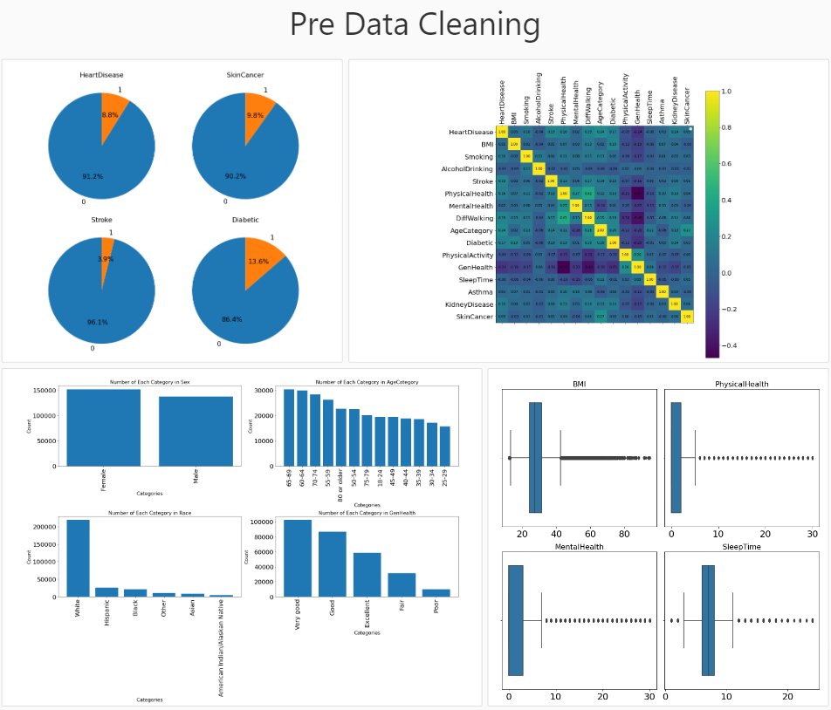
Dashboard
Inclusive of our Exploratory Data Analysis (EDA)

Slide 6
Joseph
Target Variable: Stroke
Hypothesis: "There is a positive association between shorter sleep duration and the risk of experiencing a stroke."

Slide 7
Process
Trained Models (with target variables):
Unbalanced dataset
Undersampled dataset with a 50-50 split
Undersample majority class with a 60-40 split
Trained Models (without target variables):
Undersample majority class with a 60-40 split
Feature Selection
Best Model Tuning
Answering the hypothesis

Slide 8
Evaluation Metrics
Accuracy, precision, recall, f1-score and Confusion matrix is used to evaluate the performance of the model.
The aim of the models is to be able to predict patients with stroke better and at the same time not mistake patients that do not have stroke as patients that do. Thus we prioritize increasing the percentage of True positives and decreasing the percentage of False negatives and hopefully be able to reach an equilibrium to find the best model and the best dataset that does both of these

Slide 9
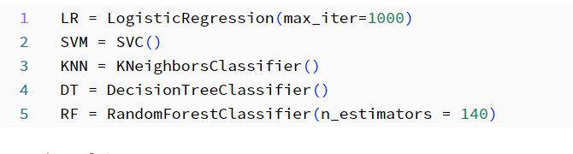
Models Used
Models used include:
Logistic Regression
SVM
K Neighbours classifier
Decision Tree
Random Forest

Slide 10
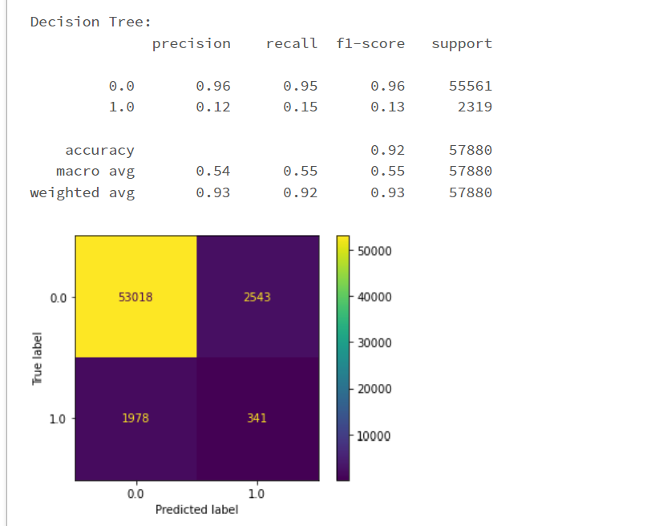
Unbalanced dataset with target variables
(best model)

Slide 11
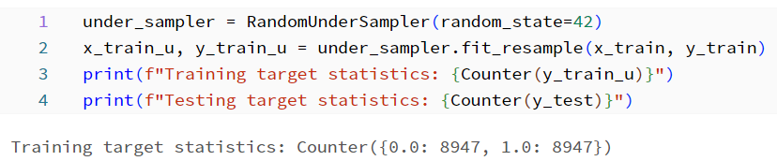
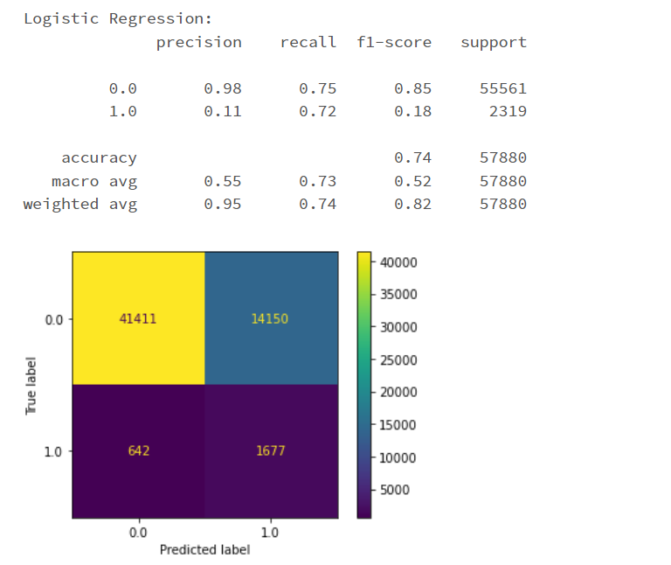
Undersampled dataset 50-50 split with target variables
(best model)

Slide 12
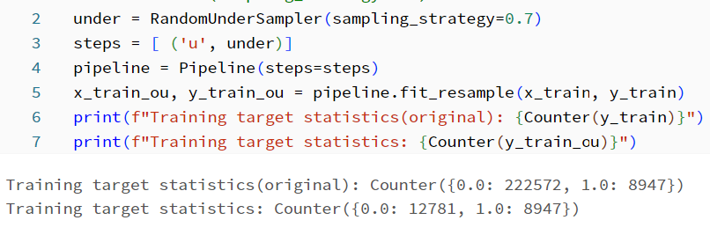

Undersampled dataset 40-60 split with target variables
(best model)

Slide 13
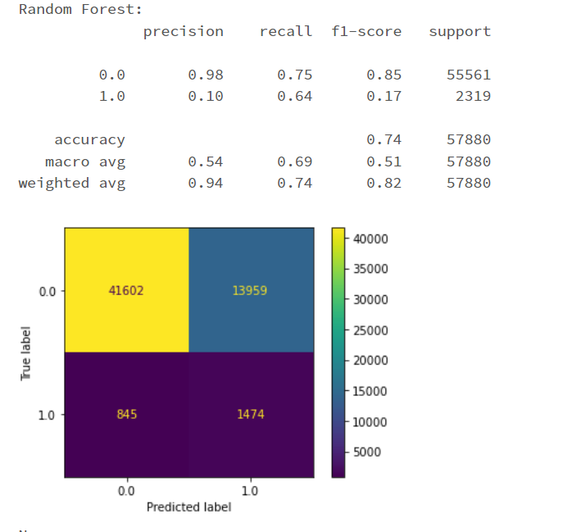
Undersampled dataset 40-60 split without target variables
(best model)

Slide 14
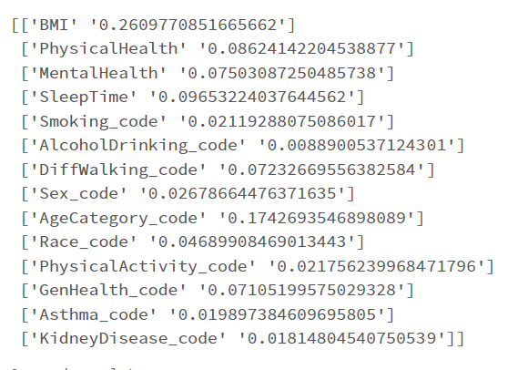
Feature Selection
After many trial and error, training the models on subsets of data, the features selected are BMI, Physical health, GenHealth, and SleepTime.

Slide 15
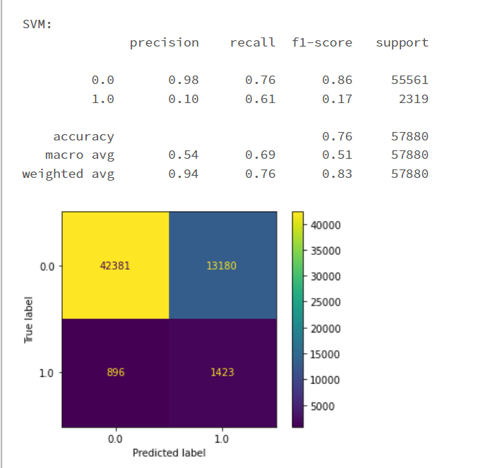
Undersampled 40-60 split with selected features

Slide 16
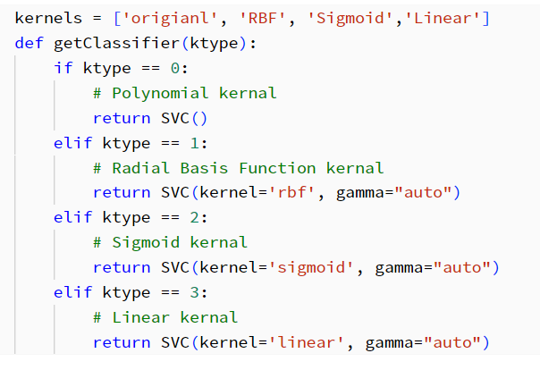
Fine Tuning

Slide 17
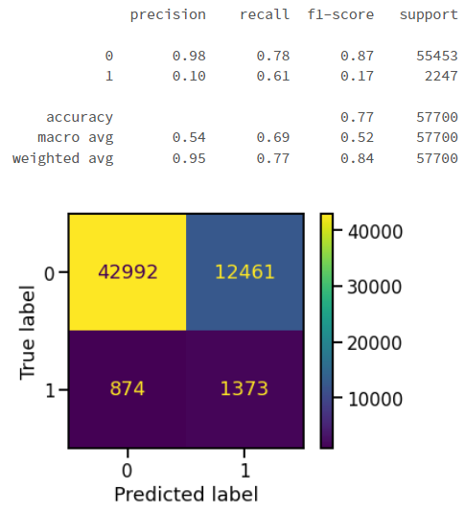
Fine Tuning best model(SVM)

Slide 18
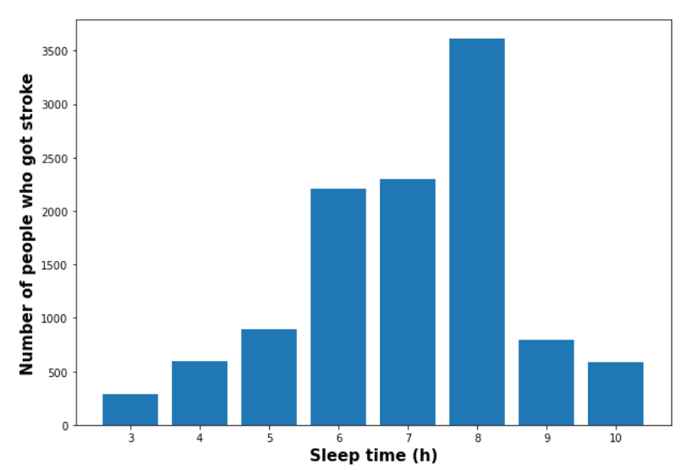
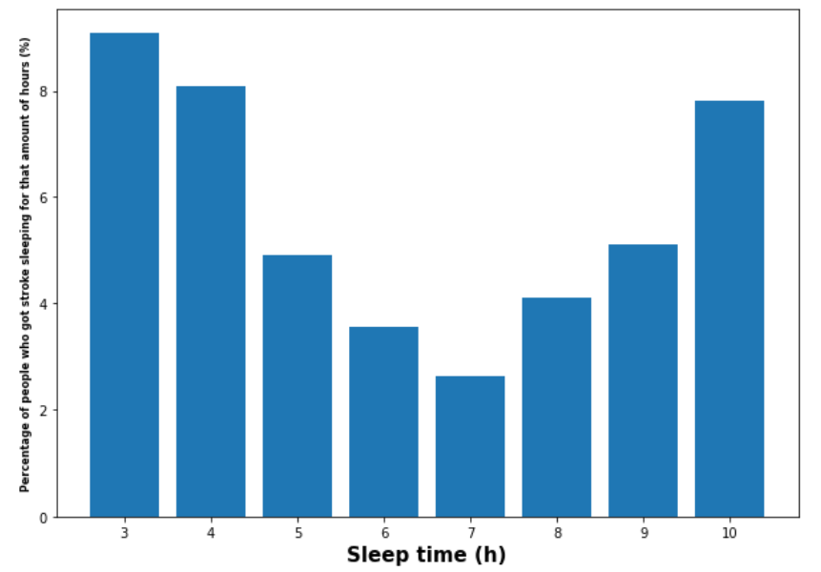
Answer Hypothesis
From the feature importance, we can see that SleepTime is indeed important in predicting if a patient has stroke or not.
From the chart that was plotted by number, sleeping between 6-8 hours has the highest likelihood of getting stroke. If we look at the chart based on the percentage of people who got stroke as compared to the total number of people sleeping in a certain range of time, we can see that in fact people sleeping less have a higher chance of getting stroke with the exception of 10 hours. We can therefore conclude that the hypothesis that "There is a positive association between shorter sleep duration and the risk of experiencing a stroke." is false.

Slide 19
Nicole
Target Variable: Diabetes
Hypothesis: "There is a positive relationship between a patient's BMI and their likelihood of developing diabetes”
."

Slide 20
Process of Tuning
Model Development 1 : Inclusive of all target variables
Model Development 2 : Exclusive of other target variables (Stroke, Skin Cancer and Heart Disease)
Comparison between 1 and 2 - Use Model Development 2
Model Development 3 : Undersampling the data (50-50 split)
Model Development 4 : Oversampling the data (50-50 split)
Model Development 5 : Smoteenn Sampling (50-50 split) – uses both under and over sampling
Comparison between 3, 4 and 5 - Use Model Development 3
Model Development 6 : Feature Selection - conducting feature importance
Comparison between 3 and 6 - Use Model Development 3
Model Development 7 : Hyper-parameter tuning on the best model

Slide 21
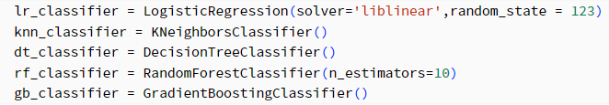
Models Used
Models used include:
Logistic Regression
K Nearest Neighbour
Decision Tree
Random Forest
Gradient Boosting

Slide 22
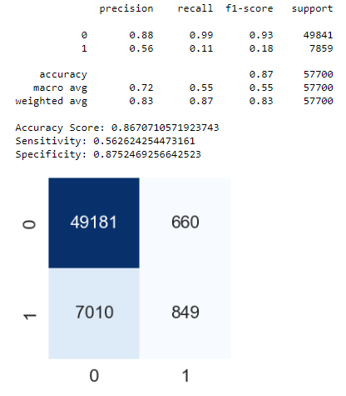
Model Development 1
Inclusive of all target Variables
Without feature selection
Without data balancing
Without hyper-parameter tuning
Current “Best” Model - Logistic Regression

Slide 23
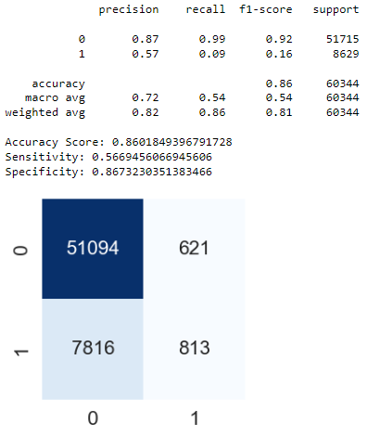
Model Development 2
Exclusive of other target Variables (Stroke, Skin Cancer and Heart Disease)
Without feature selection
Without data balancing
Without hyper-parameter tuning
Current “Best” Model - Gradient Boosting

Slide 24
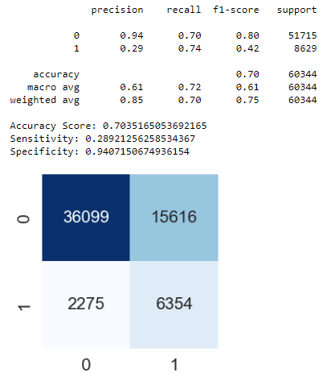
Model Development 3 (BEST MODEL)
Undersampling the data (50-50 split)
Exclusive of other target Variables (Stroke, Skin Cancer and Heart Disease)
Without feature selection
Without hyper-parameter tuning
Current “Best” Model : Gradient Boosting

Slide 25
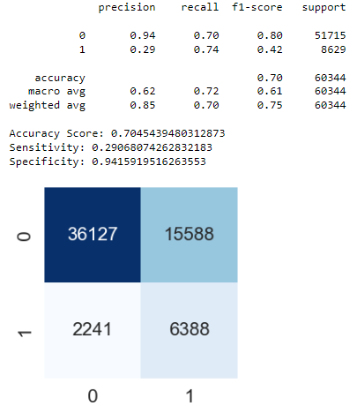
Model Development 4
Oversampling the data (50-50 split)
Exclusive of other target Variables (Stroke, Skin Cancer and Heart Disease)
Without feature selection
Without hyper-parameter tuning
Current “Best” Model : Gradient Boosting

Slide 26
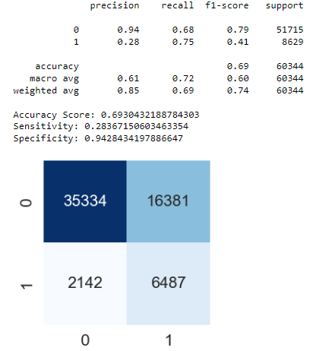
Model Development 5
Smoteenn-sampling the data (50-50 split)
Exclusive of other target Variables (Stroke, Skin Cancer and Heart Disease)
Without feature selection
Without hyper-parameter tuning
Current “Best” Model : Gradient Boosting

Slide 27
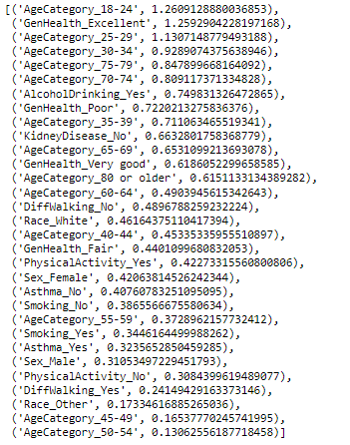
Model Development 6
Undersampling the data (50-50 split)
Exclusive of other target Variables (Stroke, Skin Cancer and Heart Disease)
With feature selection
Without hyper-parameter tuning
Current “Best” Model : Gradient Boosting

Slide 28
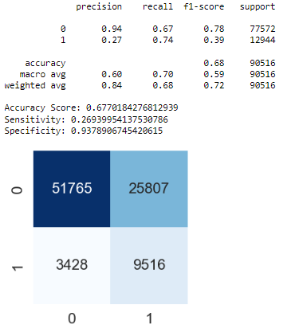
Model Development 6
Undersampling the data (50-50 split)
Exclusive of other target Variables (Stroke, Skin Cancer and Heart Disease)
With feature selection
Without hyper-parameter tuning
Current “Best” Model : Gradient Boosting

Slide 29
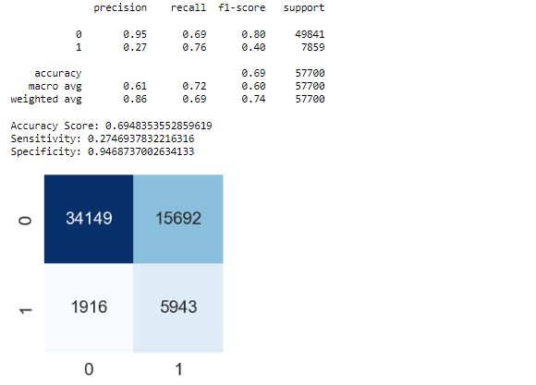
Model Development 7
Undersampling the data (50-50 split)
Exclusive of other target Variables (Stroke, Skin Cancer and Heart Disease)
Without feature selection
With hyper-parameter tuning
Current “Best” Model : Gradient Boosting

Slide 30
BEST MODEL
Undersampling the data (50-50 split)
Exclusive of other target Variables (Stroke, Skin Cancer and Heart Disease)
Without feature selection
Without hyper-parameter tuning
BEST Model : Gradient Boosting

Slide 31
Reasoning for Hypothesis
Hypothesis: “There is a positive relationship between a patient's BMI and their likelihood of developing diabetes”
From the feature extraction section, we can see that when the feature importance for each of the feature was shown, the feature importance as shown is at 0.06. Hence, when performing feature selection, i have done a removal of features based on a certain threshold.
Low Feature importance of BMI = does not affect prediction
Therefore, BMI has little to no relation on whether or not an individual has diabetes, making our hypothesis FALSE.

Slide 32
Recommendation
Here are my recommendations to HCA in identifying patients who are likely to develop Diabetes::
Based on the feature importance, pay more attention to patients within the age category range of 18-24 and those who are alcohol drinkers.

Slide 33
Charmaine
Target Variable: Skin Cancer
Hypothesis: "White individuals have a higher incidence of skin cancer compared to individuals of other races."

Slide 34
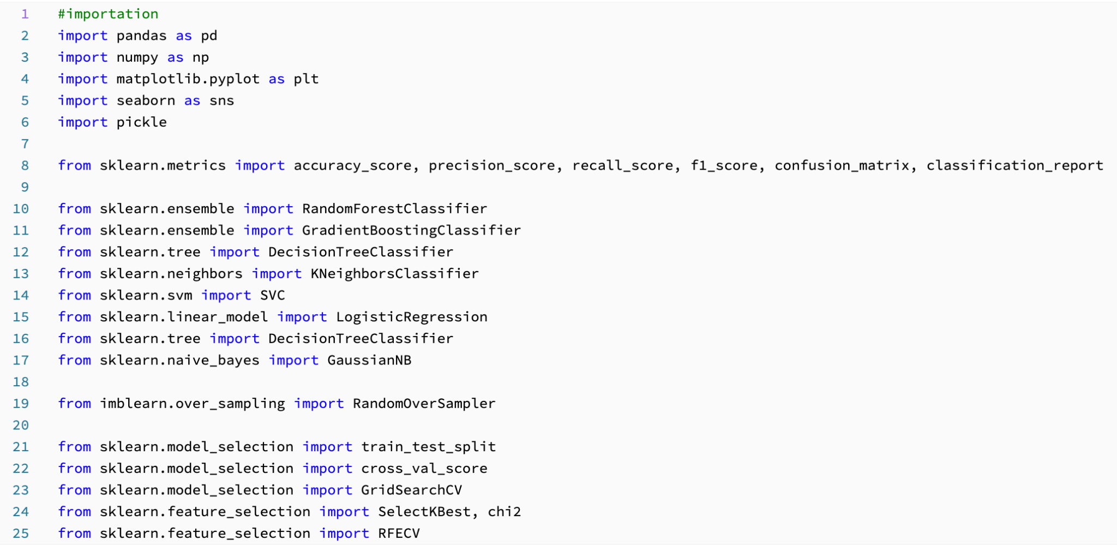
Imported Libraries

Slide 35
Process
Model (unbalanced)
Feature Importance
Trained Model
Oversampling
Model Development (without all target variable)
Best Model Tuning
Answering Hypothesis

Slide 36
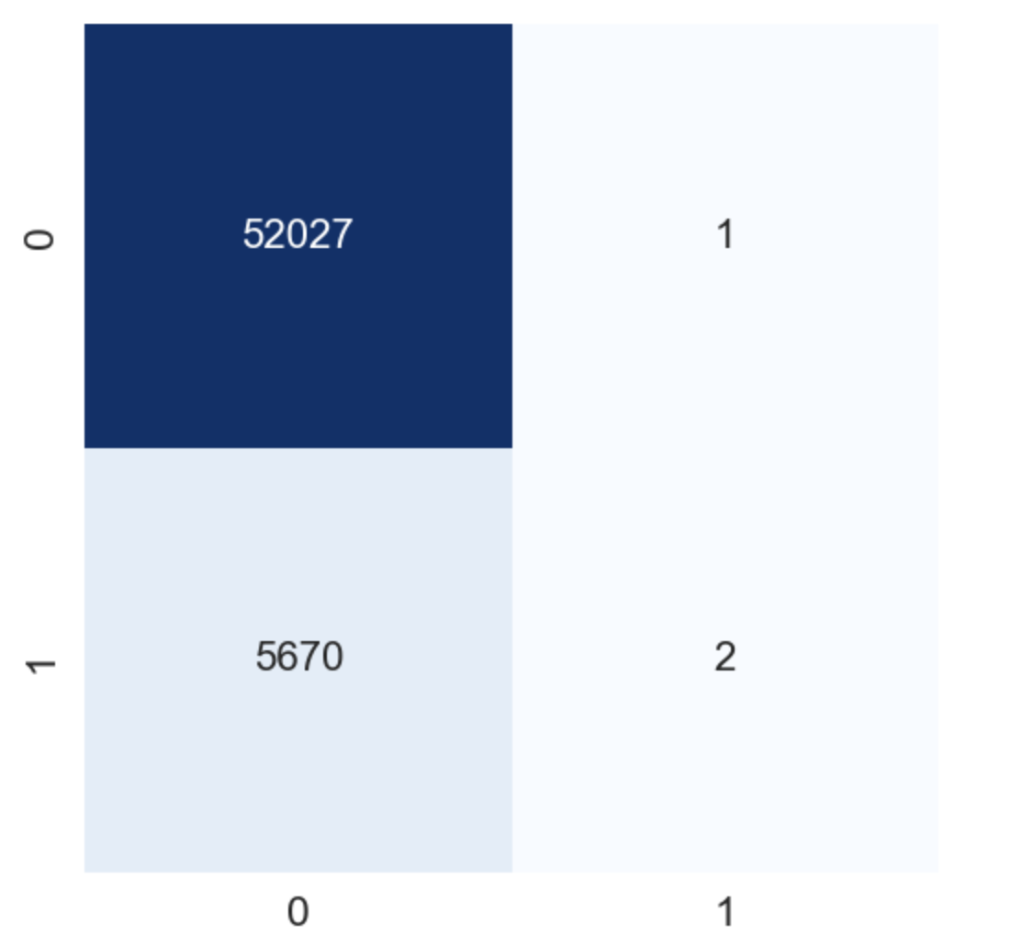
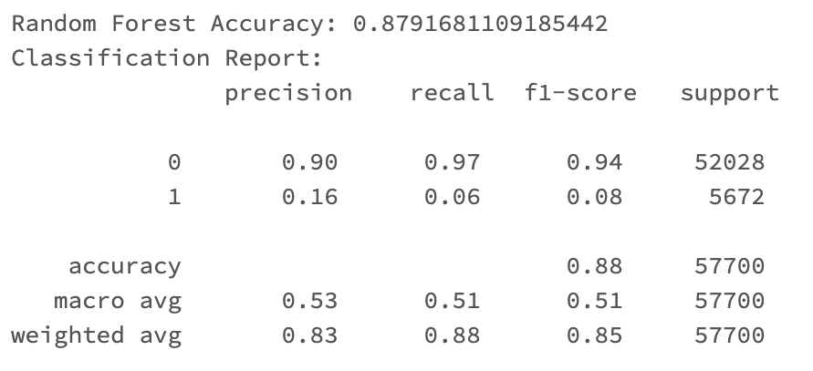
Unbalanced Model

Slide 37
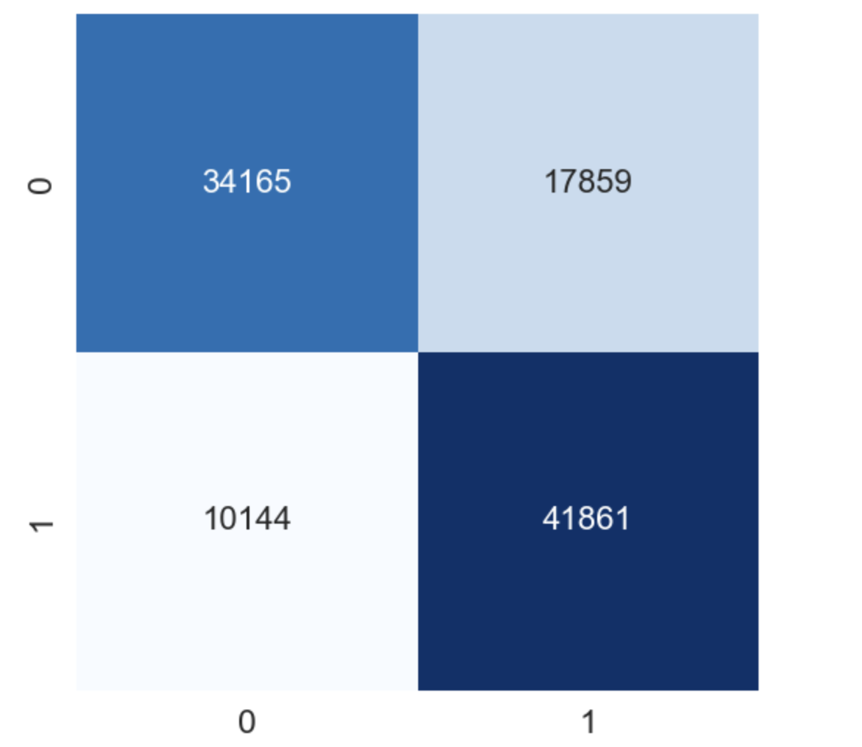
After 50-50 Oversampling

Slide 38
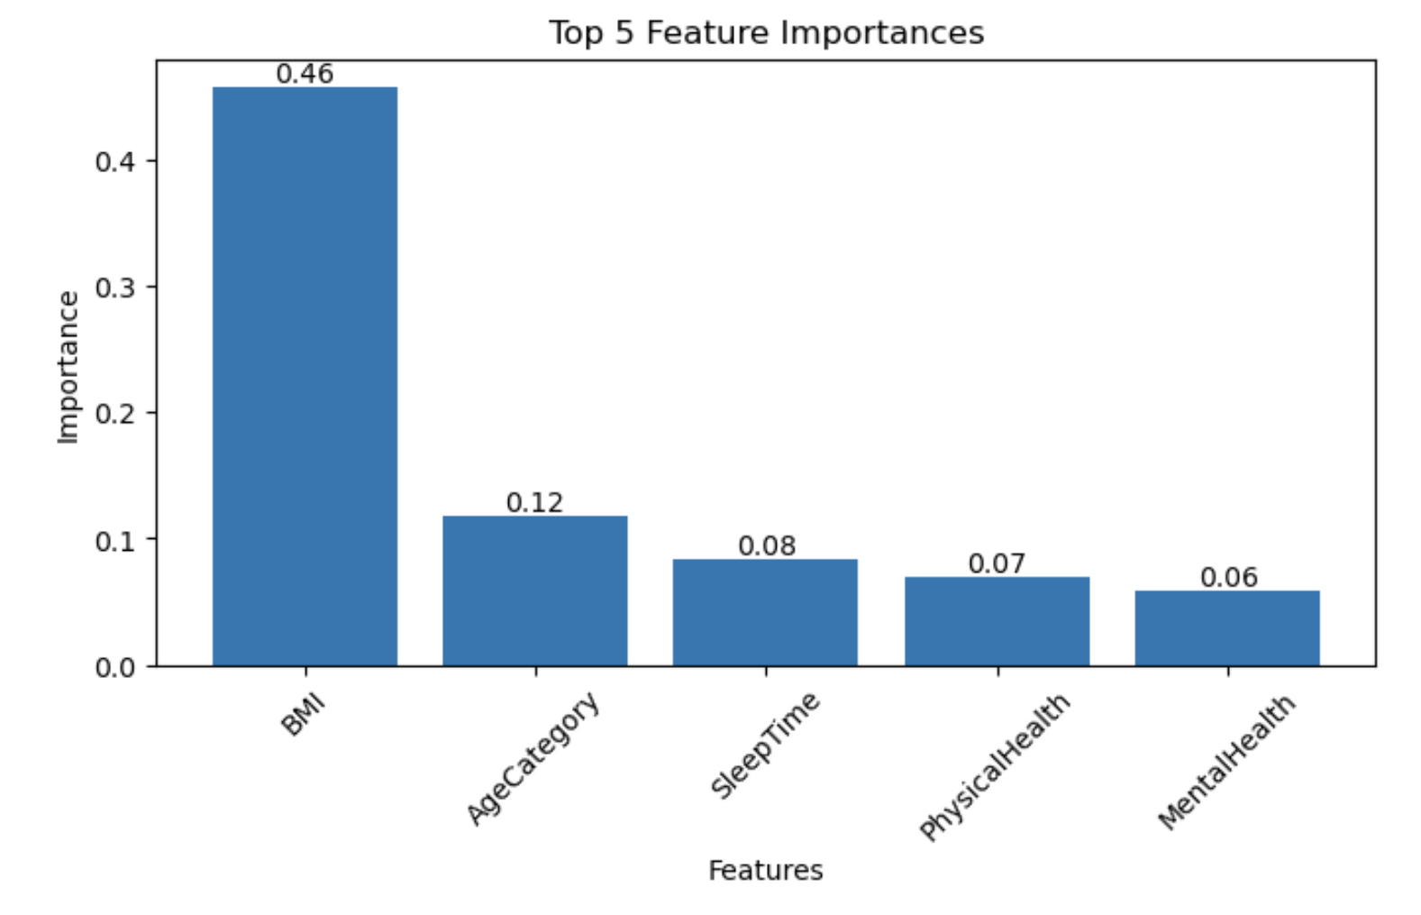
Feature Importance
When Measuring feature importance, BMI, Age, SleepTime, Physical Health, and Mental Health have the highest feature importance.
Neither of the target variables nor did race affect.
Target variables were removed after this, seeing its low to no effect.

Slide 39
Model
KNeighborsClassifier
Logistic Regression
Decision Tree
GaussianNB
Random Forest
Gradient Boosting

Slide 40
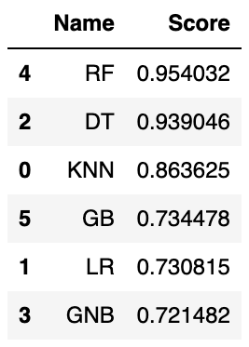
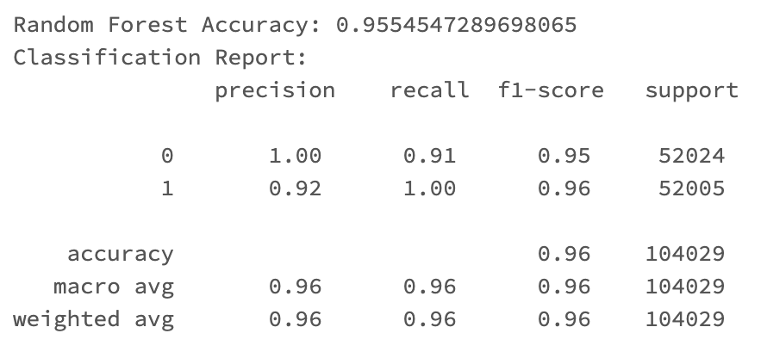
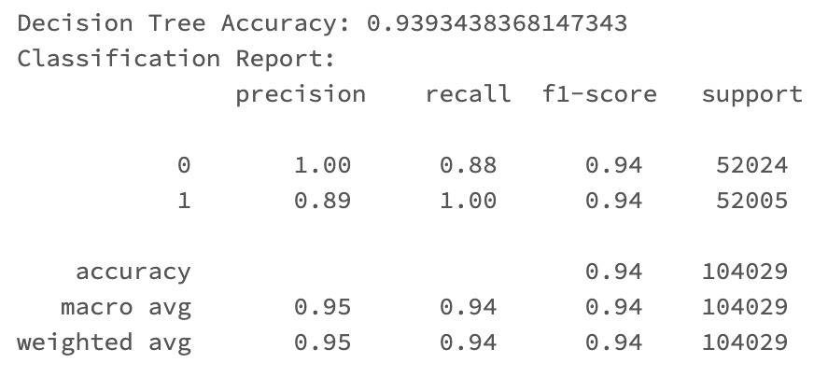
Random Forest & Decision Tree
Notes:
(too high of recall and precision) too accurate. Won’t use because of overfitting.

Slide 41
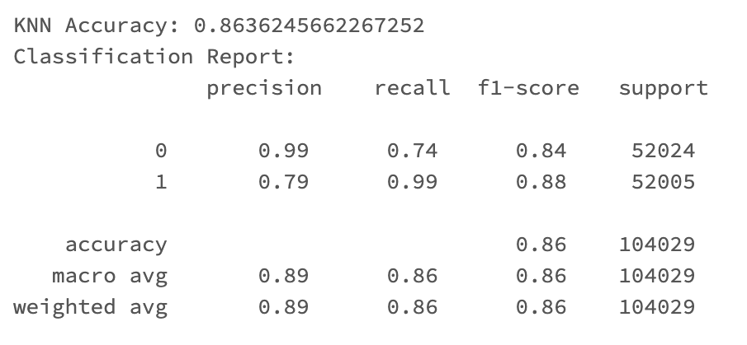
KNN Model
Notes:
(too high of recall and precision) too accurate. Won’t use because of overfitting.

Slide 42
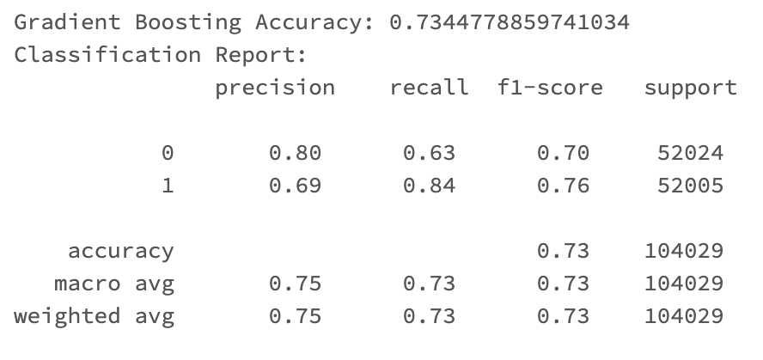
Gradient Boosting

Slide 43
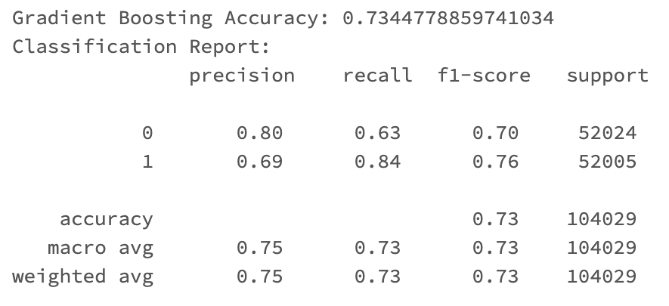
Fine-tuning (Gradient Boosting)
Accuracy
Gradient Boosting Before Fine tuning: 0.73448
Gradient Boosting After Fine tuning: 0.73540

Slide 44
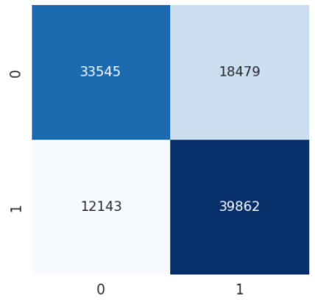
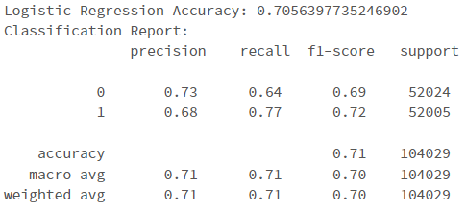
Streaming data

Slide 45
Hypothesis
Hypothesis: "White individuals have a higher incidence of skin cancer compared to individuals of other races."
False. When finding out feature importance, Race(White) did not appear to be in its top 5 features that affect Skin Cancer.
Based on the feature importance, BMI is of a higher feature importance to Skin Cancer.
Therefore, it's recommended for healthcare worker to recommend to patients to exercise regularly to keep BMI in a healthy range.

Slide 46
Andrew
Target Variable: Heart Disease
Hypothesis: "There is a positive correlation between a patient's BMI (Body Mass Index) and their likelihood of developing heart disease."
Notes:
Thank you, Charmaine. I’m Andrew and I will talk about my process of developing models to verify whether the hypothesis is true and identifying patients who are likely to have heart disease.

Slide 47
Process
Trained Models (without target variables):
Random undersampling 0:1 to a ratio of 60:40
Random undersampling 0:1 to a ratio of 50:50
Random undersampling and SMOTE 0:1 to a 50:50
Further Model Tuning
Hyperparameter tuning of all models and evaluating the model’s precision and recall.
Feature selection on tree-based models (Random Forest and Gradient Boosting).
Model Evaluation
Evaluate model based on their recall, precision, and number of false negatives.
Best Model Performance and Explainability
Use LIME, Learning Rate, ROC-AUC curve.
Notes:
Here is my process. Firstly, I train default models without target variables using different sampling methods. Next, I determine the best sampling approach and perform further model tuning. Afterward, I evaluate the best model based on the recall, precision, and number of false negatives. Lastly, I identify the best model and check its performance.

Slide 48

Models Used
I tried using the following models and their respective reason:
Gradient Boosting - combines the predictions of multiple weak models to create a strong predictive model
Logistic Regression - works well when the decision boundary between classes is close to linear.
Decision Tree Classifier - captures complex relationships in the data
Random Forest Classifier - robust, handles non-linearities well
Linear SVC - effective when the classes are linearly separable or nearly so
Notes:
Here are the models I used. There are a total of 5 models as seen on the screen.

Slide 49
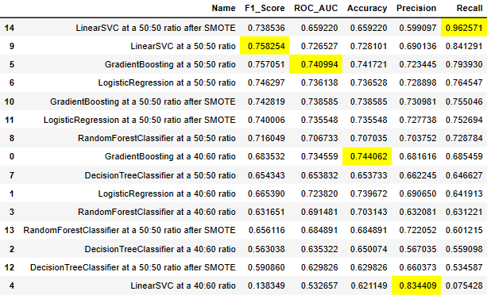
Default Models Training
LinearSVC has high difference between precision and recall
I evaluate the model based on the recall and precision metric. I ensure the precision and recall does not differ much (>0.2) and ensure the ROC_AUC is good.
0:1 class at a 50:50 ratio seems to be the best sampling split for model performance.
The top models are LinearSVC, Gradient Boosting, LogisticRegression, and Random Forest Classifier.
Notes:
Firstly, the default model training with different sampling methods and size. After training the model on all types of sampling methods, I sorted the result based on their recall. Looking at the recall and precision, LinearSVC, Gradient Boosting, Logistic Regression, and Random Forest are the top 4 models. Although the first LinearSVC with a 50:50 ratio after SMOTE has the highest recall, the precision and recall difference is high, which could indicate the model’s inability to learn patterns to identify the true negatives. Therefore, the best sampling method is random undersampling at a 50:50 ratio.

Slide 50
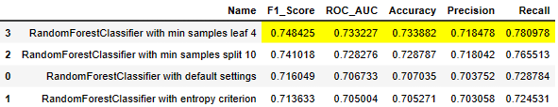
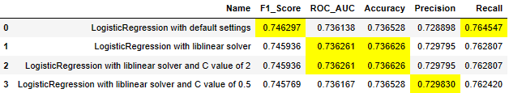
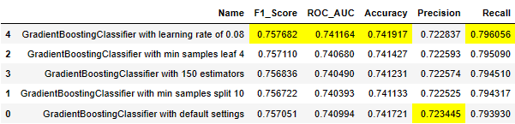
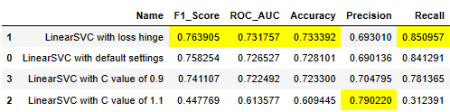
Model Tuning
For each model mentioned previously - LinearSVC, Gradient Boosting, LogisticRegression, and Random Forest Classifier, I did hyper parameter tuning and feature selection (with Random Forest).
I passed in some hyperparameters in an attempt to reduce the model’s false negative rate and improve the recall.
Notes:
After identifying the top models and the sampling method, I went on to try some tunings on the models. My goal is to reduce the model’s false negative, which is in the recall.
Liblinear is for large-scale linear classification and C value of 1.1 reduces generalization of data.

Slide 51
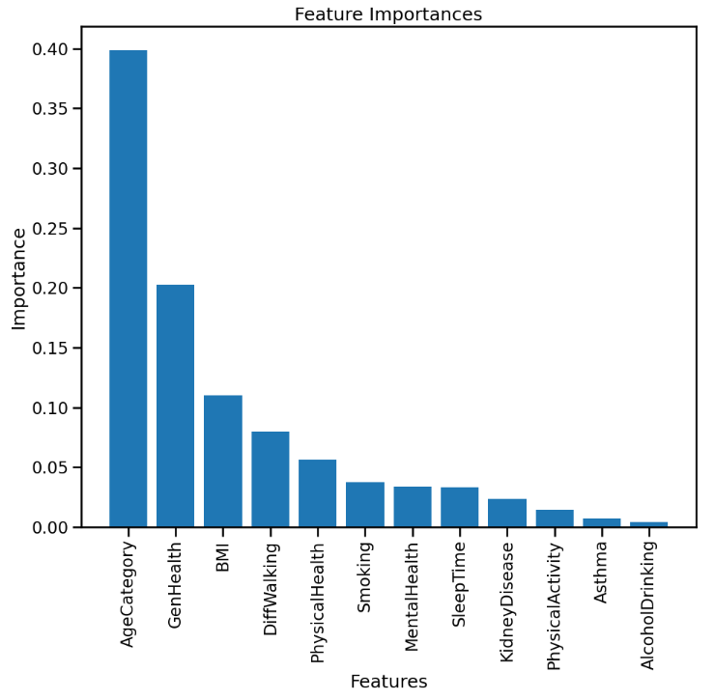
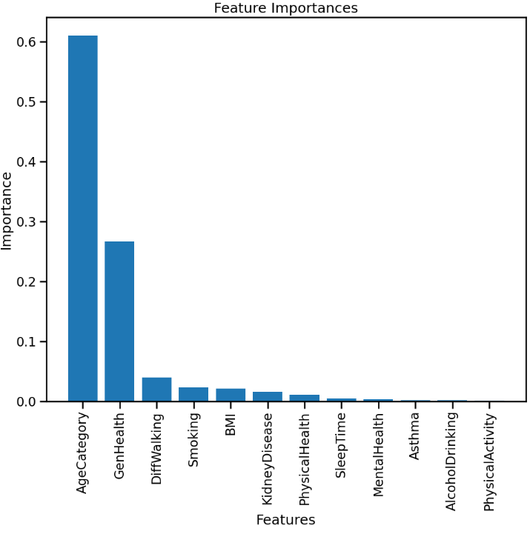
Feature Selection
Feature Selection was done on tree-based models - Random Forest and Gradient Boosting Classifier.
For both models, I used a threshold of 0.015 and the number of False Positives and Negatives increased by around 20 records.
Therefore, I retained the original data.
Random Forest
Gradient Boosting
Notes:
In addition to hyperparameter tuning, I did feature selection on tree based models as they have the feature importance. Here, you can see the feature importance chart of the Random Forest and Gradient Boosting classifier. In both charts, the AgeCategory and GenHealth has the highest importance.
I’ve tried feature selection with this information, setting a minimum feature importance of 0.015. However, after retraining the model without the low importance feature, the number of false positives and negatives increased.

Slide 52
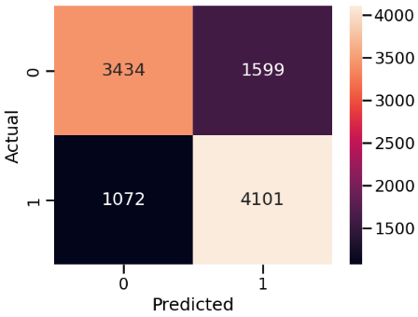
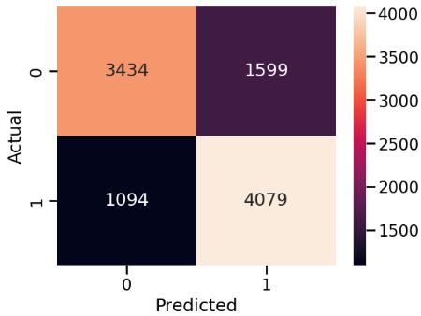

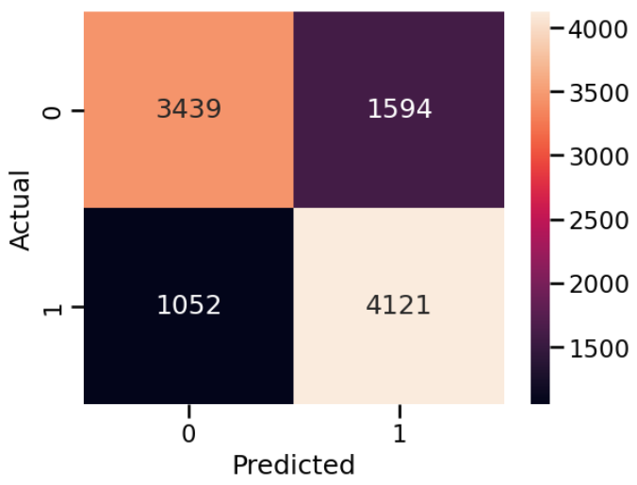
Before Feature Selection
After Feature Selection
Random Forest
Gradient Boosting
Notes:
Here, you can see that the false positives and negatives increasing slightly after feature selection. This could be due to the low importance feature still providing a bit of information on the class the record should be assigned to. Therefore, I will continue using the original data.

Slide 53
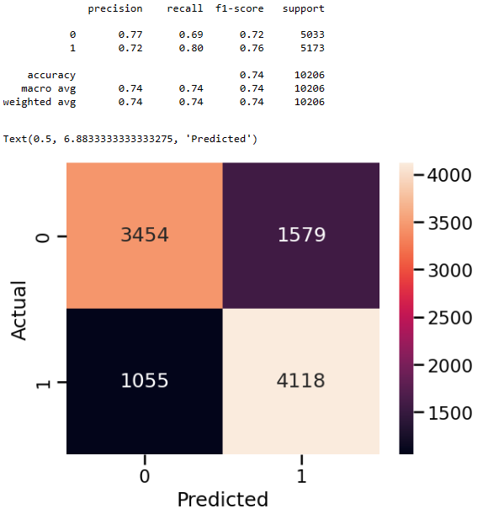

Model Evaluation
I evaluate each model’s precision and recall for the 1 class (Have Heart Disease), and False Negatives.
I choose the model with the highest class 1 recall value.
In the end, the Gradient Boosting Classifier has the best Recall and lowest False Negatives. The difference between precision and recall is not large either.
Notes:
Here is my evaluation of the models. I check their precision and recall for the 1 class and look at the number of false negatives for each model. In the end, the Gradient Boosting Classifier has the best result as it has the highest recall and the precision recall difference is not large.

Slide 54
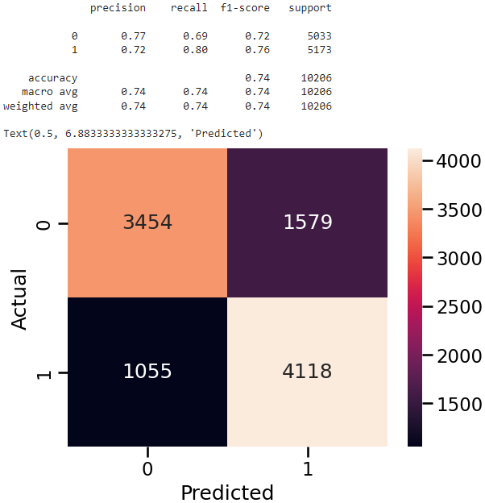

Best Model
Here is my best model - Gradient Boosting Classifier.
Notes:
Here was my tuning of the model. The only hyperparameter I added was a lower learning rate, allowing the model to move slower toward identifying the optimal weights. This result in a good balance between recall and precision, showing that the model works well with both classes.

Slide 55
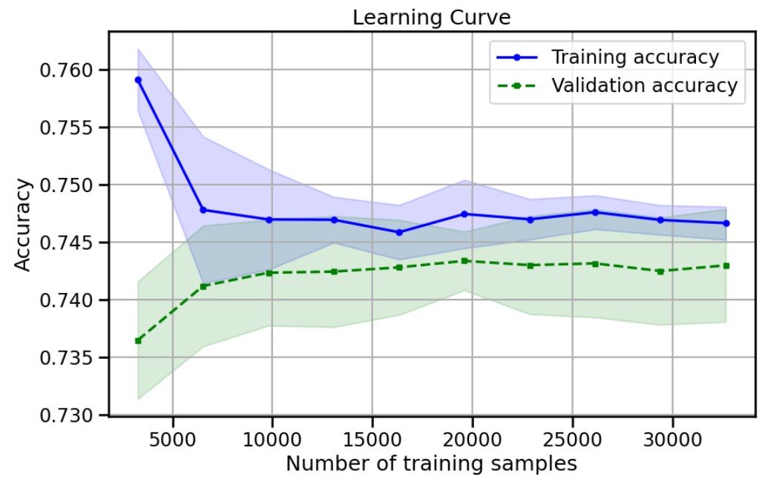
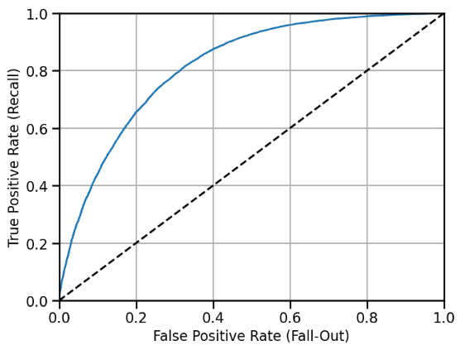
Best Model Performance Check
After getting the best model, it’s time to answer the most pressing question - is the model over/under-fitted?
Learning Curve accuracies become similar with 0.005 difference, indicating the model is not over or under-fitted.
AUC_ROC Score = 0.8169
Notes:
After getting the best model, there is the question of whether the model is over or under fitted. Therefore, I look at the AUC_ROC and learning curve. The AUC_ROC curve is relatively higher than the line for random guessing, with an AUC_ROC score of 0.81.
The learning curve also becomes similar, within a range of 0.005 from 10,000 records onward. The similarity in learning curve accuracies suggests that the model is not over or under fitted.
Ignore: It is normal that the training accuracy goes down when the dataset size grows. Think of it this way: when you have fewer samples, it is easy to fit a model that has good accuracy for the training data. However, that fitted model is not going to generalize well for test data. As the dataset size increase, the model is able to learn more pattern and fit the training data, helping the model generalize better for the validation data.

Slide 56
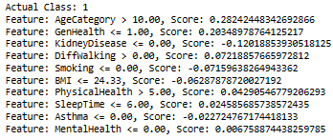


Best Model Explainability
Gradient Boosting model explainability with LIME.
Positive scores are for class 1
Negative scores are for class 0
Notes:
Next, I look at the model’s explainability using LIME.
For each record, I can obtain the probability score of each class, get the weightage of each feature, and look at the overall visual for determining the record’s class.
For this case, the probability for class 1 is 0.85. Looking at the feature’s score,.AgeCategory and GenHealth have a high score of 0.48 while the negative values total to around negative 0.15. Since the positive probability is higher than negative, the record is classified as positive.

Slide 57



Feature Impact on Prediction
Partial Dependency of each feature
Notes:
Next, I look at the partial dependency plot. Looking at the overall partial dependency plot, only AgeCategory and GenHealth has a significant impact on the patient’s outcome as their dependency score can range from 1.0 to more than negative 2.0, meaning a higher weightage in model predictions.
However, BMI’s range is only from 0.05 to negative 0.30.

Slide 58

Is the Hypothesis correct?
False!
The original hypothesis: "There is a positive correlation between a patient's BMI (Body Mass Index) and their likelihood of developing heart disease."
Notes:
Therefore, is the hypothesis correct? The answer is no! Looking at the feature importance, partial dependency, and some LIME examples, the BMI contributes little to the likelihood of a patient developing Heart Disease.

Slide 59
Recommendations
Here are my recommendations to HCA in identifying patients who are likely to develop heart disease:
Pay more attention to patients of a higher age category (45 years old and above) and patients with a poorer stated general health (Poor/Fair/Good).
Integration of the Gradient Boosting model to your electronic health records system for automation of detection.
Notes:
To conclude, here is my recommendations to HCA in identifying patients who are likely to develop heart disease. Pay more attention to patients of a higher age category which is 45 years old and above, and patients with a poorer stated general health like poor or fair.
I also recommend integrating this gradient boosting classifier to HCA’s electronic health records system for automation of detection, which could help HCA focus on my important tasks like treating those flagged patients.

Slide 60


Let’s move on to a live demo of data streaming on Databricks.

